Slide 1
Neural Networks: An Introduction
COMP 4230
Fall 2024
Thanks to Andrew Kotey and Matt Grover

Slide 2
Alerts
Read Larson chapter 7
Read Matthew Stewart's Introduction to Neural Networks
(https://towardsdatascience.com/simple-introduction-to-neural-networks-ac1d7c3d7a2c)

Slide 3
Symbolic vs. Sub-symbolic Representation
Notes:
Andrew

Slide 4
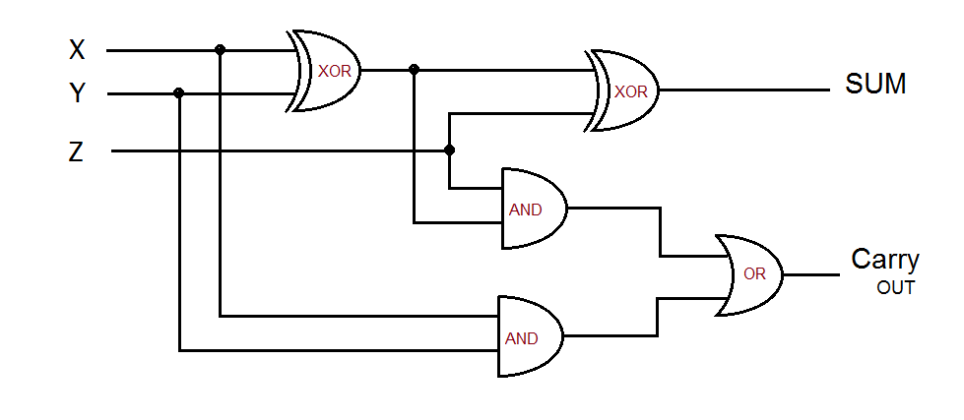
Full Adder
Consider the simulation of this electronic circuit
Notes:
Andrew

Slide 5
Naïve Symbolic Representation
If (x = 0 and y = 1 and z = 1) Then s = 0 and c = 1
If (x = 1 and y = 1 and z = 1) Then s = 1 and c = 1
• • •
Rules representing behavior of components
Explicit representation of the causal interactions within the system.
Notes:
Andrew

Slide 6
Just Like Expert Systems
MYCIN
IF: (1) the stain of the organism is gram-positive, and
(2) the morphology of the
organism is coccus, and
(3) the growth conformation
of the organism is clumps
THEN
there is suggestive evidence (0.7)
that the identity of the organism
is staphylococcus.
• • •
The main disadvantage of symbolic representations is figuring out these causal interactions
Notes:
Andrew

Slide 7
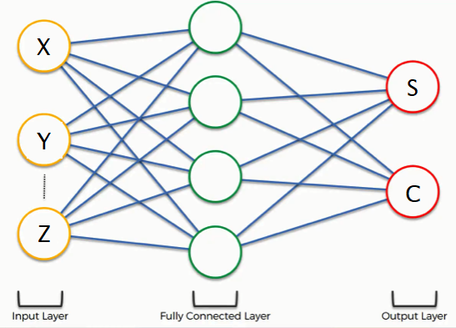
Neural Networks
sub-symbolic (what does this mean?)
learns behaviour from examples.
no explicit representation of causal interactions.
representation is distributed or sub-symbolic
Notes:
Andrew

Slide 8
A theoretical framework
Notes:
Andrew

Slide 9
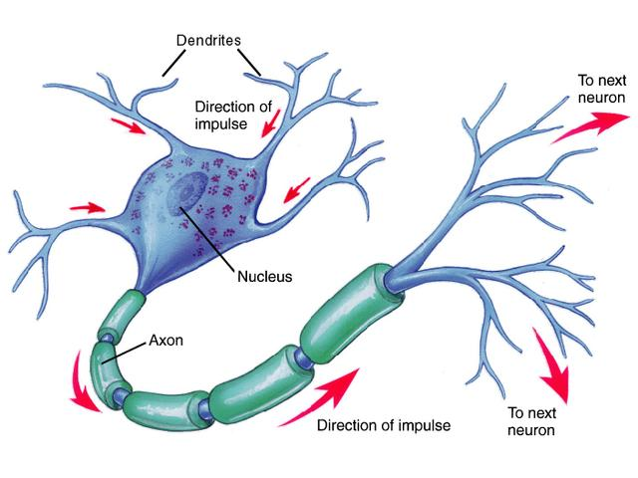
Threshold Logic
Built to Model Biological Neural Activity...
Conceptual model for human neural processing
Weighted inputs represent the signal coming into the neuron
Input (excitatory and inhibitory) is summed in the cell body
If voltage threshold is reached, the neuron fires
Notes:
Matt

Slide 10
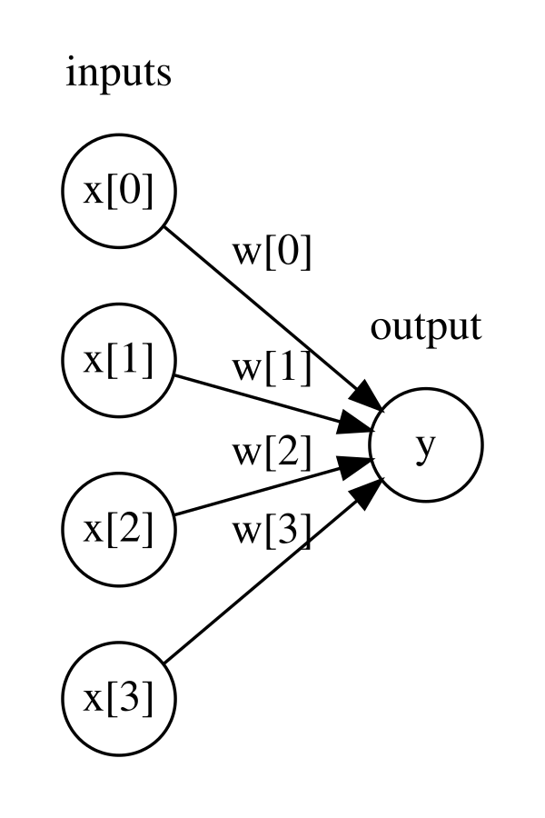
Threshold Logic
Built to Model Biological Neural Activity...
Developed by Warren McCulloch & Walter Pitts (1943)
Theoretical Model not implemented until the perceptron
Notes:
Andrew

Slide 11
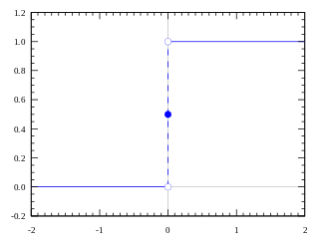
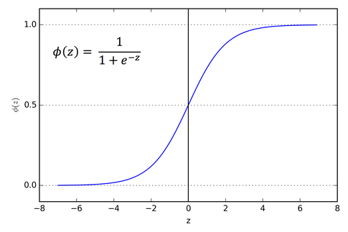
Threshold Logic
Heaviside Step Function
Activation function - responsible for taking a weighted sum of inputs
In a step function, activation boils down to a 1 or 0
Sigmoidal Squashing Function
Notes:
Matt

Slide 12
Implementation & Early Optimism
Notes:
Matt

Slide 13
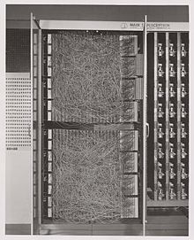
Perceptron
Developed by Frank Rosenblatt 1958
First artificial neural network produced with a learning rule
Used for visual processing
Could register images
Could correctly classify cats vs. dogs (but no spatial awareness)
Mark 1 Perceptron
Notes:
Matt

Slide 14
Fatal Flaws & Criticism
Notes:
Andrew

Slide 15
Marvin Minsky & Seymour Papert
Solvable with single-layer perceptron
Problems associated with Perceptrons:
Incapable of solving non-linear problems with single-layer
Excessive Processing Time
Killed Neural Nets for more than a decade
Not solvable with single-layer perceptron
Notes:
Andrew

Slide 16
Alternative Models
Notes:
Matt

Slide 17
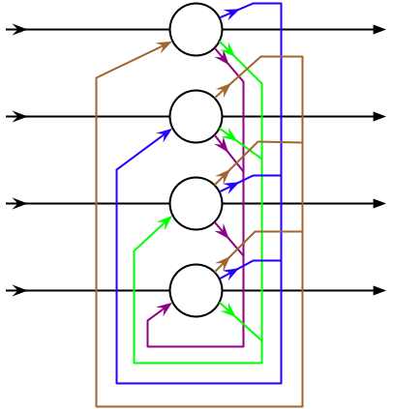
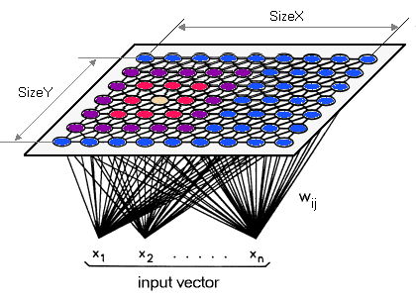
1982
Hopfield Networks
Based on dynamical systems in mathematics and spin glass systems in physics
Recurrent Neural Network
Kohonen Self-Organizing Maps
Competitive learning rather than error-correction learning
Unsupervised
Preserves topological structure
Notes:
Andrew

Slide 18
A long-awaited breakthrough
Notes:
Matt

Slide 19
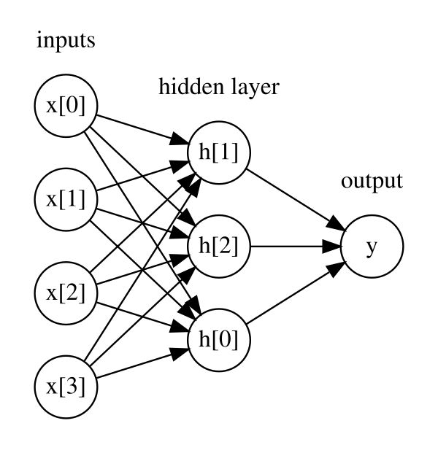
Multilayer Perceptrons & Backpropagation
Notes:
Matt

Slide 20
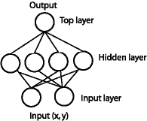
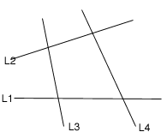
MultiLayer Perceptrons
Modification of Single - layer Perceptrons
Adding a layer of hidden units allows perceptron to solve problems that are not linearly separable
Each hidden unit allows for another linear “slice” of the data
Breakthrough was development of learning algorithm: backpropagation
“Hidden Units”
Notes:
Andrew

Slide 21
MultiLayer Perceptrons
Activation Functions
Sigmoid functions allow for continuous (non-discrete) activation of nodes
Not “all-or-none”
Perceptual gradient in real life (i.e. Sense of touch, auditory volume, etc.)
Action potentials in our nervous system are still “all-or-none”, but frequency of neurons firing represents the strength of external stimulus
More Complex Activation Functions
Notes:
Matt

Slide 22
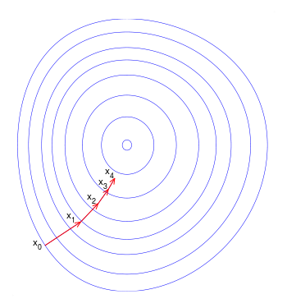
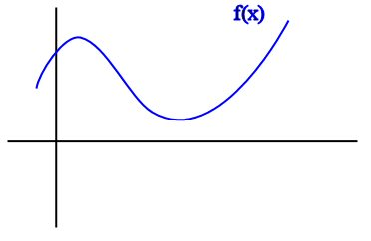
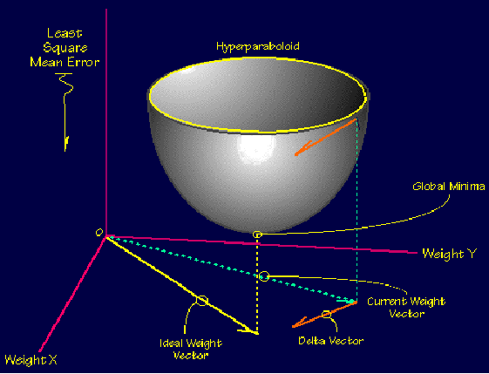
Gradient Descent
Process by which error is minimized
Conceptually similar to using derivatives to find function minimum
This is why the activation function must be continuous and differentiable
Notes:
Matt

Slide 23
Backpropagation
(Backwards propagation of errors)
To minimize error function, it is necessary that the network’s activation function be differentiable
Heaviside step function is not continuous, therefore not differentiable
Requires a known, desired output for each input value
Supervised Learning
Walk-through the algorithm
David Rumelhart & James McClelland published Parallel Distributed Processing in 1986
Advent of the “backpropagation” learning rule
Notes:
Andrew

Slide 24
Advantages and Disadvantages
Advantages:
Has the ability to capture information in large amounts of data
Builds very complex models
Good with “simple problem”
Pattern recognition, speech recognition, perceptual processing of data, etc..
Disadvantages:
Tuning parameters for better accuracy
Training intensive
Not the best with heterogeneous data
Hard to decipher results
Notes:
Andrew

